Slide 1
Ecological response to drought for Northern Great Plains Streams
Charles Jason Tinant
Associate Professor Oglala Lakota College
PhD Candidate Civil & Environmental Engineering SDSM&T

Slide 2

General Observations
The changing climate is among the greatest threats to Indigenous Peoples
Equitable quantification of Tribal Rights to Water is a substantial near-term question for US Tribes
Indigenous peoples’ identity & traditional perspectives are implicitly linked to social and ecological sustainability
Water
Tribal
Water Rights
Food
Energy

Slide 3
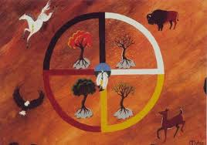

VISION: Tribal Sustainability
Sustainability - capacity to endure
Ecology - biological diversity & productivity over time.
Society - potential for long-term maintenance of well-being; depends on maintenance of the natural world
Mitákuye Oyás’iŋ
All Are Relations - Lakota concept of living in harmony with our relatives: other people, animals, birds, fish, plants, hydrosphere & lithosphere
https://ouroborosponderosa.wordpress.com/2011/11/22/mitakuye-oyasin-a-lakota-sioux-prayer/
Ecology Info Center - http://environment-ecology.com

Slide 4
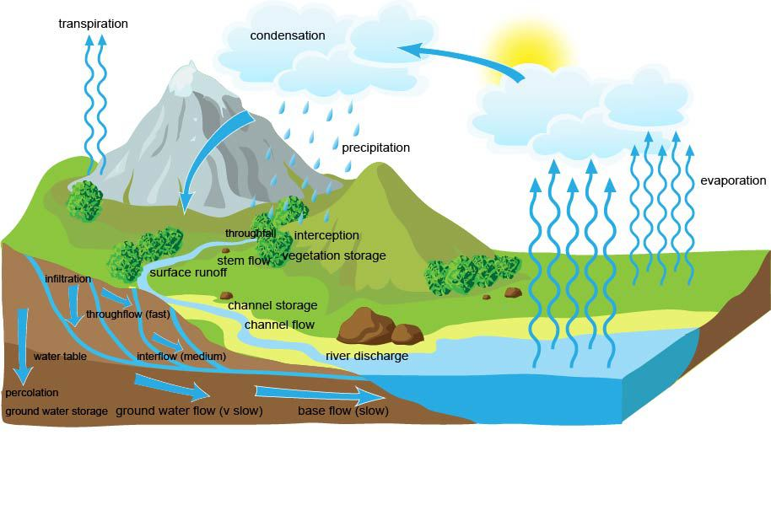
Freshwater Biotic Integrity is a Sustainability METRIC
Streams are watershed “thermometers”
All land uses in a watershed are reflected in lakes & streams
Pollutants,
Changes in hydroperiod—urbanization, surface water abstractions,
Unsustainable groundwater use
Biotic metrics—measure sustainability practices within the watershed—but need calibration
Generalized watershed hydrology
Source: www.alevelgeography.com

Slide 5
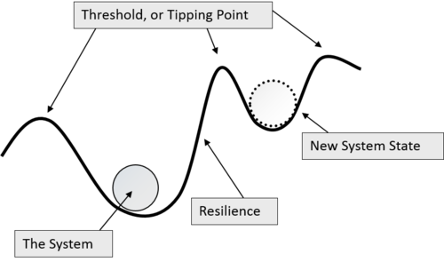
Invertebrate stream community composition began to change around 2000
Past findings: Declines in biotic metrics don’t correlate with increases in bacteria or NO3 concentration, or declines in habitat quality
Present questions: Is there another explanatory variable? Droughts?
Are there other biotic metrics robust to natural disturbance & sensitive to anthropogenic disturbance?
Pre-2000 community EPT-dominated
during wet period
What happened
here?
Post-2000 community
Dipterans & non-Insects
following drought

Slide 6
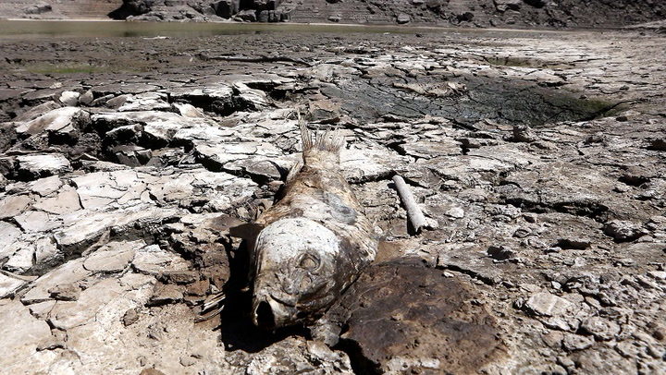
Droughts are Poorly Understood natural hazards —impact potential increases with inadequate planning
Meteorological drought: precipitation deficit—leads to—
Hydrological drought: surface & ground water deficit that recovers after precipitation and soil moisture returns to normal conditions—leads to—
Socioeconomic drought: water demand exceeds water supply—leads to over-allocation, competing beneficial uses ecosystem service undervaluation & non-sustainable groundwater use—leads to—
Ecological drought: ecosystem stress, loss of species, declines in biotic integrity
Extreme drought
South Africa, 2017-2018
https://www.timeslive.co.za/news/south-africa/2017-11-16-sa-still-plagued-by-drought/

Slide 7
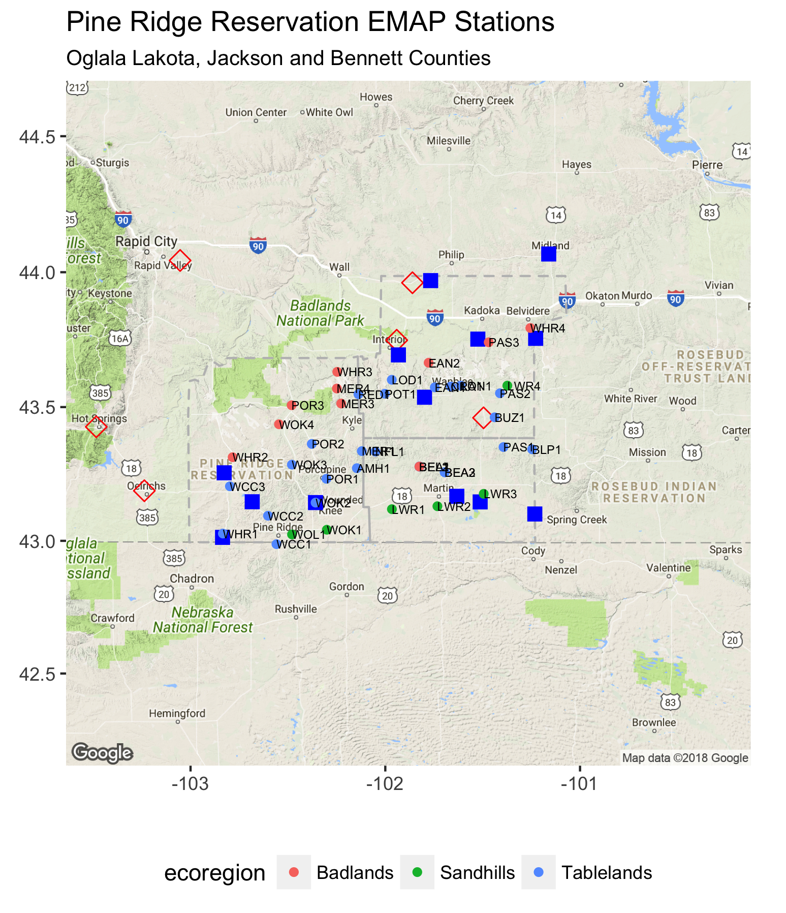
Global & Local Challenges: Major Knowledge Gaps
Need to improve information transfer approaches (downscaling) from gauged to ungauged watersheds ¹
Hydrological knowledge gaps:
Most small watersheds are ungauged with little or no available information ¹
Watershed-scale processes & feedbacks are poorly understood
Ecological knowledge gaps
“We understand how freshwater communities persist during normal and high flows better than we understand the ecological effects of droughts” ²
Weather
stations
Streamflow
gages
Chemical & Biological
Sampling Stations (N = 40)
A decade of Predictions in Ungauged Basins (PUB)—a review (Hrachowitz et al. 2014)
PS Lake - Drought and Aquatic Ecosystems: Effects and Responses

Slide 8
ApproacH: UnDerstand how DROUGHT Propagates through the region
Overall hypothesis: Drought is a key driver of invertebrate community regime shift
Nested Questions
Q1—Hydrology: Does greater porosity buffer hydrologic systems to meteorological drought? Does greater permeability decrease hydrological drought recovery lags? How rare were the 2000s droughts?
Q2—Ecology: How similar is the observed community regime shift on the PRR to other published studies? What is the relationship between hydrologic drought and community change in PRR streams?
Resistance
Pre-2000 community EPT-dominated
during wet period
Post-2000 community
Dipterans & non-Insects
following drought

Slide 9






Q1—Hydrology: Does greater porosity buffer hydrologic systems to meteorological drought? Does greater permeability decrease hydrological drought recovery lags? How rare were the 2000s droughts?
Random Forest
Test Set
Soil statistics
gSSURGO
Ungauged
Precipitation
time series
SPI Index
Transformation
Random Forest
Training Set
Soil statistics
gSSURGO
Gauged
Random
Forest
Stream
discharge
time series
Stream
discharge
time series
groups
Ungauged
stream
discharge
time series
SDI Index
Transformation
Hierarchal
Clustering
Describe associations & model relationships between drought types

Slide 10




Q2—Ecology: How similar is the observed community regime shift to other published studies? What is the relationship between hydrologic drought and community change in PRR streams?
Invertebrate
sampling
data
Expected taxa
resistance & resilience
Other dryland
stream
ecology studies
Transformed ungauged
stream time series
NMS Ordination
PERMANOVA
Drought Resilient Biotic Metrics for the Pine Ridge Reservation
Quantify effects of drought intensity on invertebrate community change

Slide 11
Expected RESULTS
Hydrology
Effective porosity is analogous to to carbonate alkalinity for drought propagation from atmosphere to hydrosphere
Hydrologic systems in unconsolidated sediments should respond rapidly to a return to wet conditions—particularly high intensity convective storms
The 2000s drought are likely to be 5% to 1% events, particularly at longer averaging periods.
Ecology
Overall ecosystem resilience to drought is positively correlated with watershed storage
Our work should quantify recent droughts in other regions—helping to resolve the question of the threshold of seasonal vs. supra seasonal droughts
Expected regime shift to smaller-bodied & r-selected taxa. More gastropods following a supra seasonal drought

Slide 12
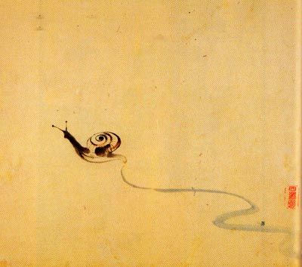
“Climb Mount Fuji
O snail.
But, slowly, slowly.”
Kobayashi Issa
All analysis in R & available on GitHub https://github.com/cjtinant
Follow me on twitter for data science, stream ecology, Tribal water rights @C_J_Tinant

